Slide 1
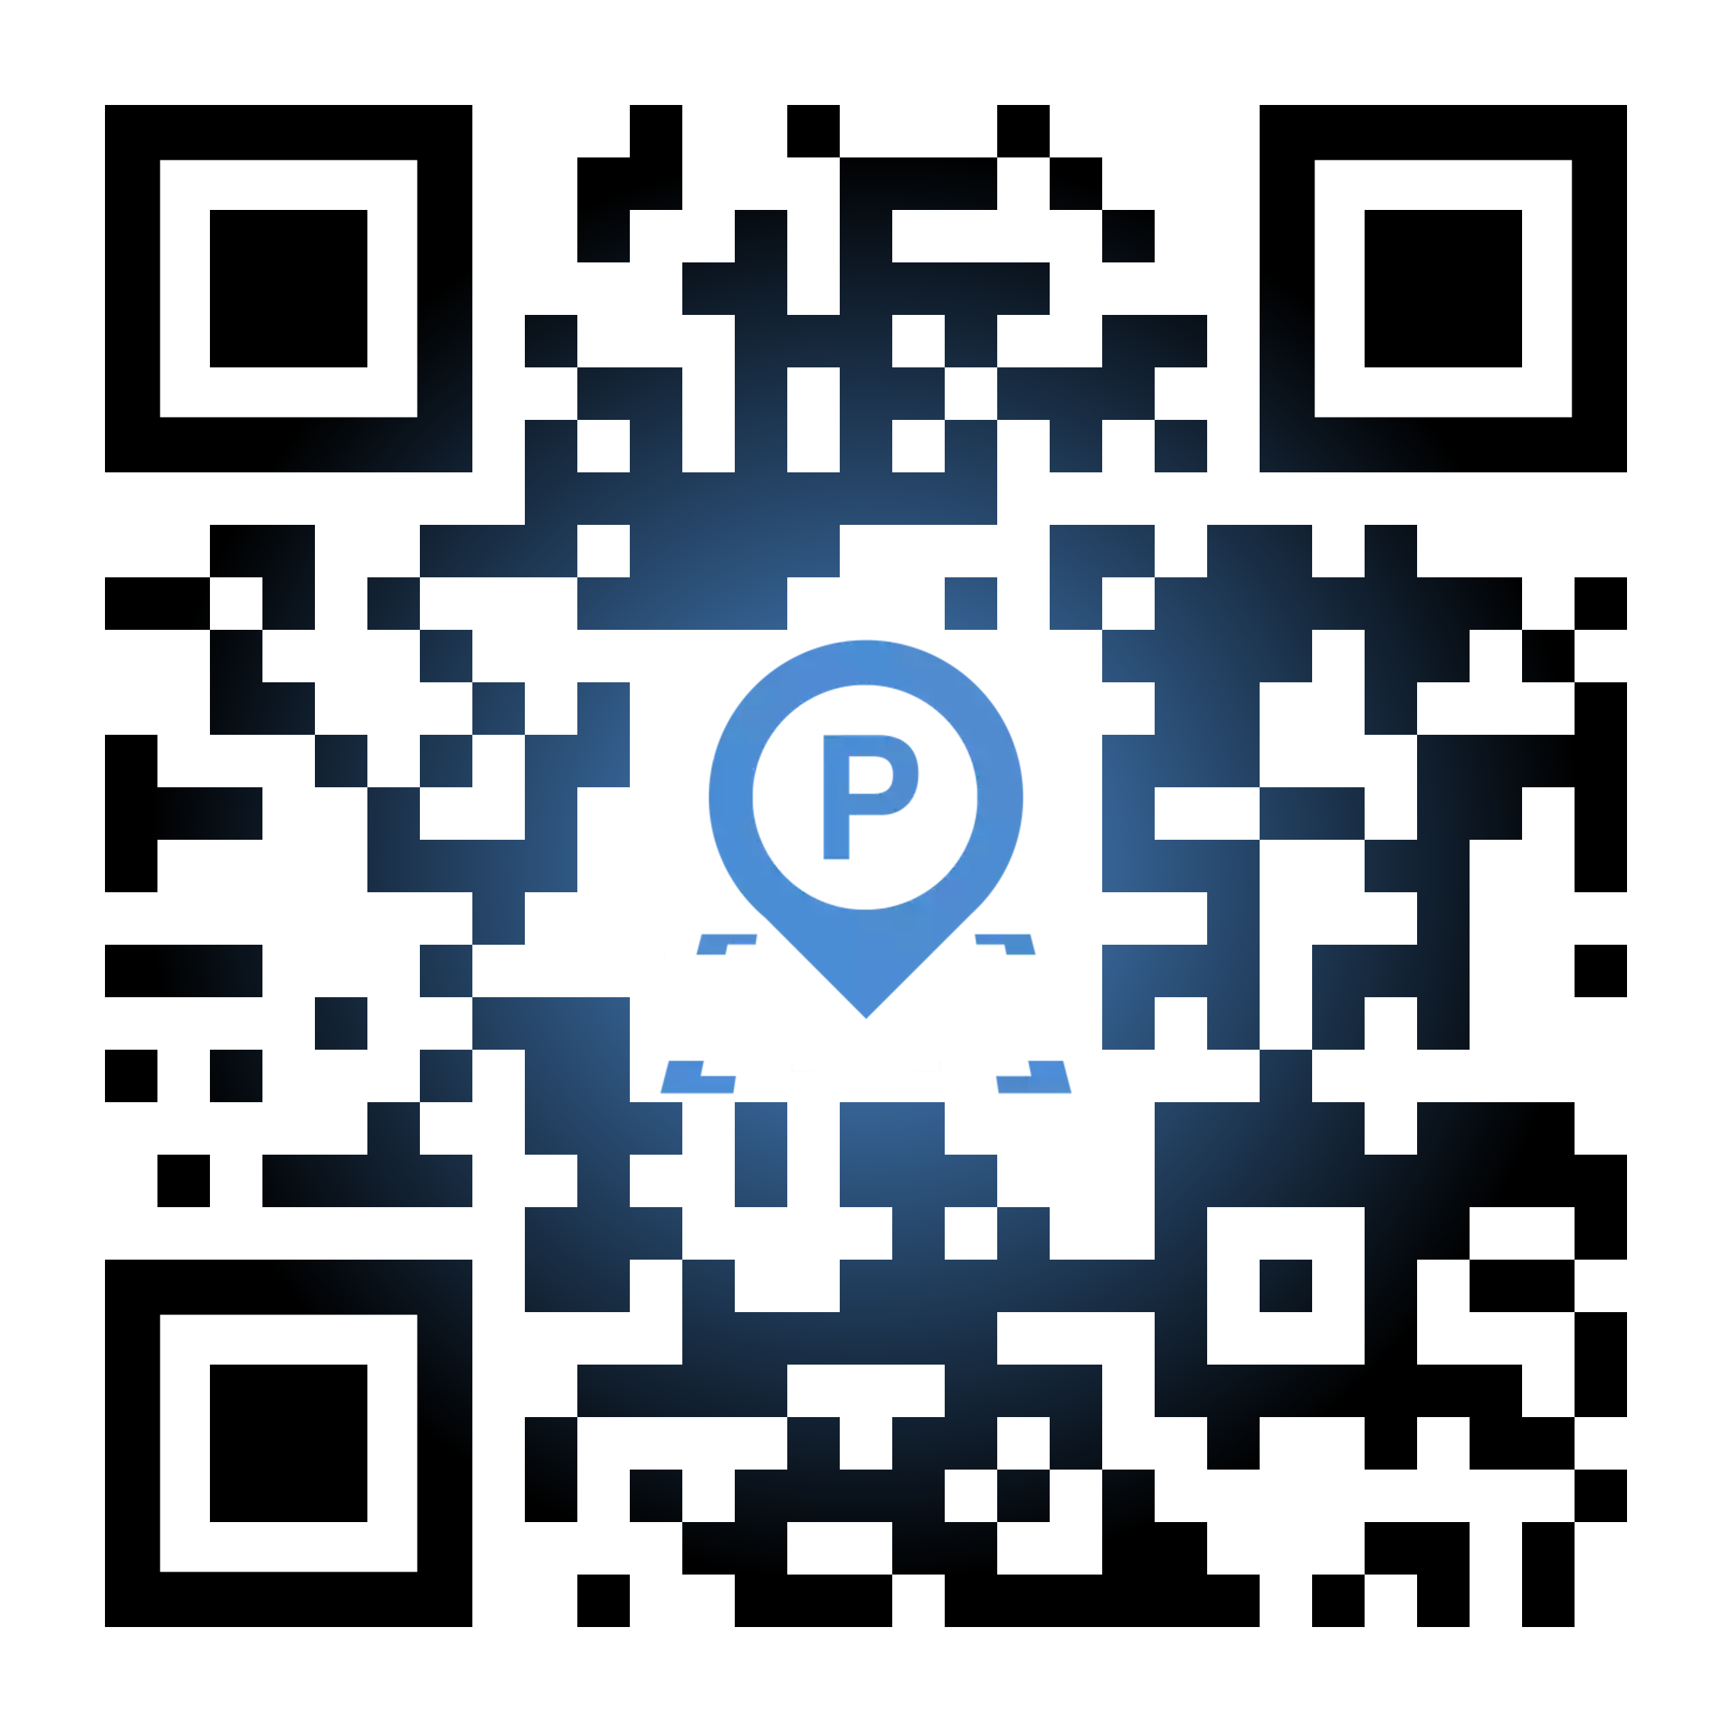
Parklux
Hello, I’m
Muhammad Habib
https://bit.ly/parklux

Slide 2
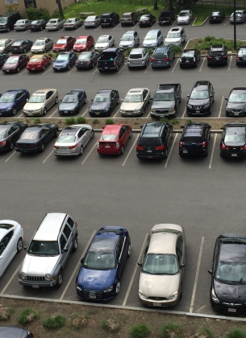
Parking
Systems

Slide 3
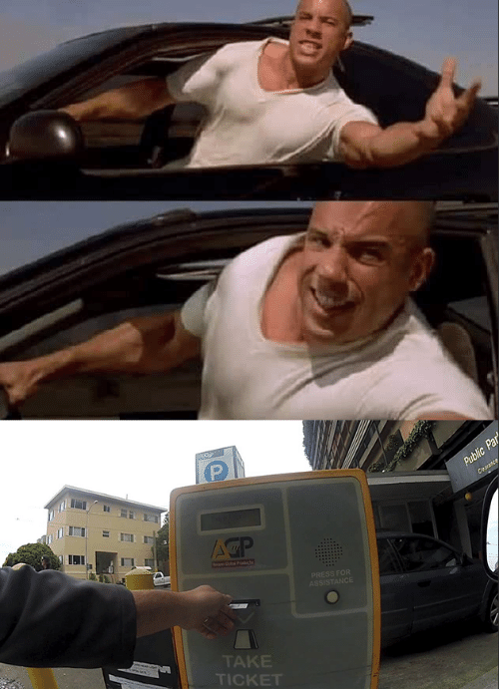
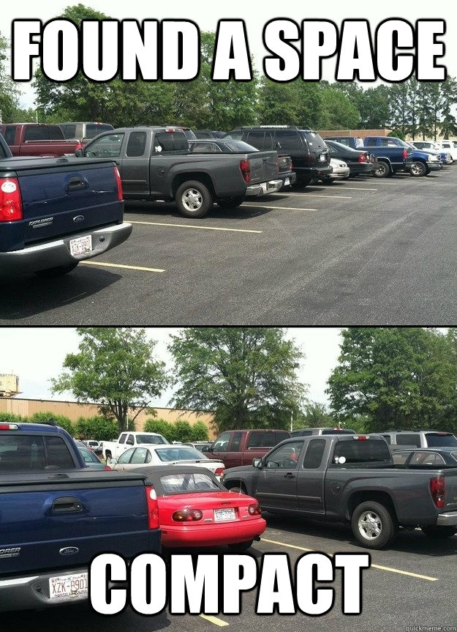
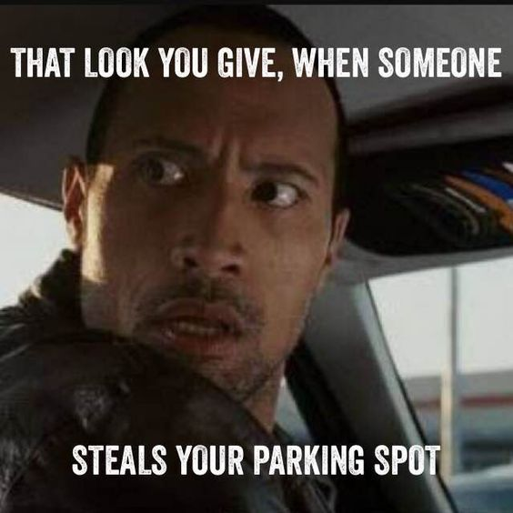
Parklux

Slide 4
USER STORY
Manage Parking Zone
Can allocation the parking slots, manage levels, sections and slots, etc.
Parking Receipt
See parking history and can share that receipt with other apps.
See Registered Parking Zone
Custom maps that shows a marker on there with parking zone details like name, price/hour, open hours and address. And can directly open Google Maps applications for directions to Parking Zone
Parklux
Manage All : Super Admin
Can see all the parking booking, see all the users and manage the users
etc...

Slide 5
Product
Scope
This application didn’t provide payment system, customer paid on checkout gate
Primarily, the scope of Parklux only for registered users
Customer can’t select parking zone system generate automatically
Application can’t provide the customers who park on wrong zone
Parklux

Slide 6



USER ROLE
CUSTOMER
ADMIN
(Parking Zone)
SUPER ADMIN

Slide 7
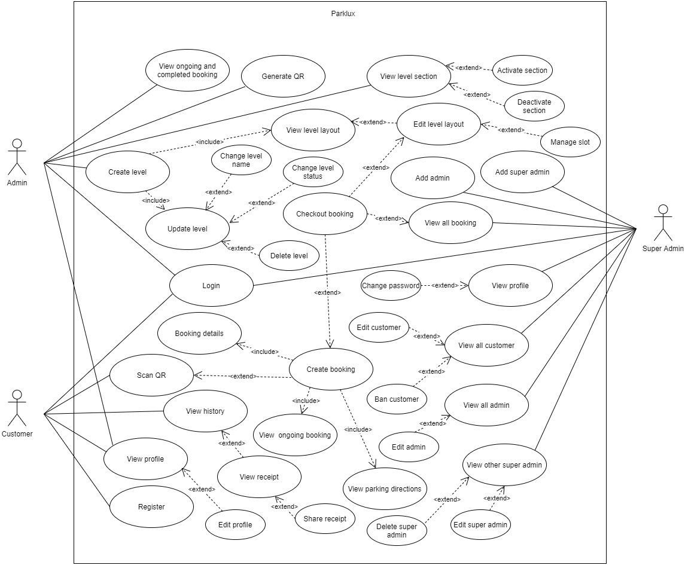
USE
CASE
Parklux

Slide 8
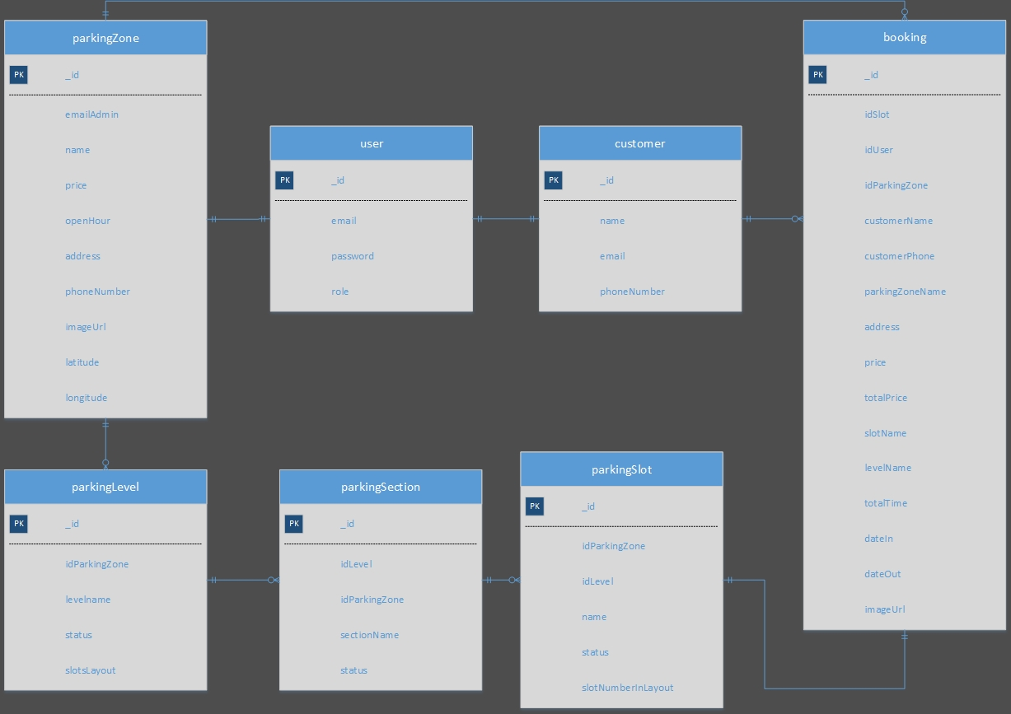
ERD
Parklux

Slide 9








Technology
Parklux

Slide 10

Parklux
DEMO

Slide 11

FUTURE
DEVELOPMENT
Generate the slot nearest with enterance not just random
Parklux
Flexibel price/hour or with a diffrence price between first or second hour, and specify the vehicle

Slide 12
THANK
YOU
Parklux

